Slide 1

Research Methods Review
What is Science?
Truthlikeness
Study Design
Null Hypothesis Testing or Not
Inferential Statistics

Slide 2
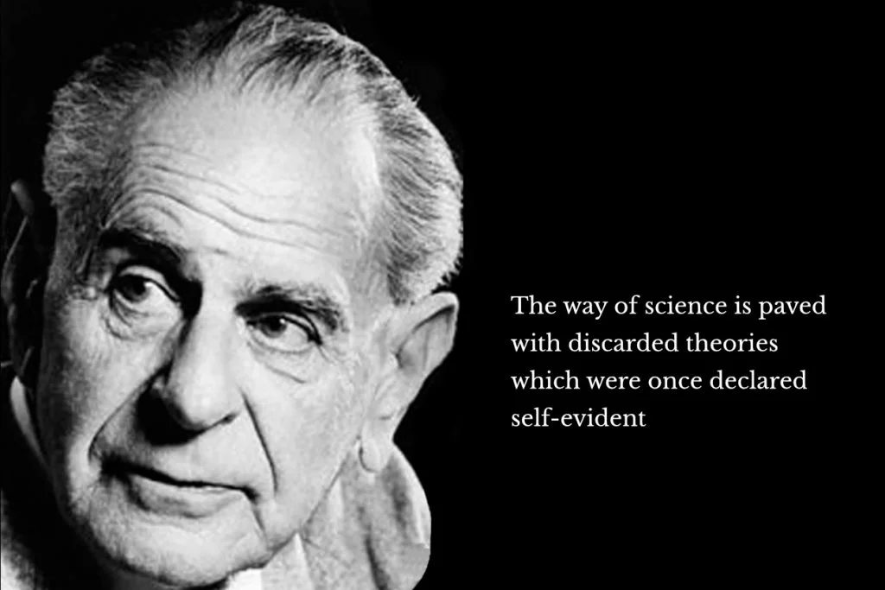
Methods of Inquiry
Authority
Rational
Scientific
What is Science?
Tenets of Science?
Empirical, Rational, Falsifiable (Testable), Parsimonious, General, Tentative, Rigorous
Bordens and Abbott Research Design and Methods: A Process Approach
https://www.researchgate.net/file.PostFileLoader.html?id=57ebd687dc332d2135033ca2&assetKey=AS%3A411302938857481%401475073670875

Slide 3
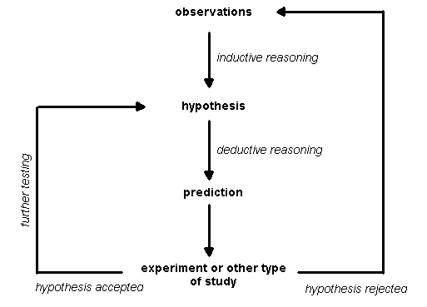
Popper’s Truthlikeness
hypothetico-deductive method
e.g. “the scientific method”
Popper: Scientific theories cannot be proven true, only falsified through testing. E.g Falsification
Popper proposed "verisimilitude" or "truthlikeness" to describe how well a theory corresponds to reality
Verisimilitude is a matter of degree, and scientific progress comes from refining theories towards greater verisimilitude
https://plato.stanford.edu/entries/truthlikeness/
Is the hypothetico-deductive method a requirement for “science”?

Slide 4
Modern Truthlikeness
Debate and criticism surround the concept of verisimilitude among philosophers of science
Semantic Approaches:
Define truthlikeness based on similarity between a theory's content and the actual state of the world (empirical)
Probabilistic Approaches:
Define truthlikeness in terms of the probability that a theory assigns to true statements or accurately represents the world (statistical)
Information-Theoretic Approaches:
Define truthlikeness in terms of information content (entropic)
Pragmatic Approaches:
Focus on practical success (predictions, explanations, technology) as a criterion for truthlikeness
Emphasize empirical success and practical utility in evaluating scientific theories

Slide 5
Study Design
Non-Experimental (Observation)
Natural-Experimental (Observing and looking natural groups)
Quasi-Experimental (Sample equal groups)
Experimental (randomly assign conditions)
Longitudinal
Dependent variables
Independent variables
Conditions
Between, within, mixed group designs
Confounding variables
Keep it simple
Main effects
Interactions
Selecting condition levels

Slide 6
Gender
Male
Female
Shoeware
no shoes
sandals
running
DV
time to run 1 mile

Slide 7
Levels of Measurement
Categorical (Nominal)
Ordinal
Interval
Ratio

Slide 8
What to do with data?
Descriptive statistics
Inferential statistics
Transformations
Plots, Visualizations

Slide 9
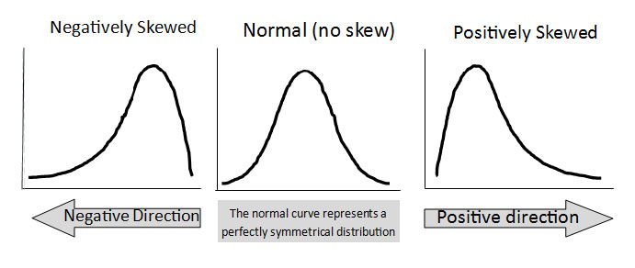
Descriptive Statistics
Counts
Measures of central tendency
Mode
Mean
Median
Measures of spread
Range
Variance
Standard Deviation
Measures of skewness
Kurtosis

Slide 10
Plots
Bar plot: Comparisons between discrete categories or groups
Line plot: Trends over time or continuous variables
Scatter plot: Correlation between two continuous variables
Multi-line plot: Trends of multiple variables over time or continuous variables in a single plot
Multi-axis plot: Two or more related variables with different units of measurement in a single plot
Multi-subplot plot: Compare multiple plots side-by-side or for showing the same variable under different conditions
Bubble plot: Three variables (x-axis, y-axis, and size of bubble)
Histogram: Distribution or frequency of a continuous variable
Box plot: Distribution and range of a continuous variable, including median, quartiles, and outliers

Slide 11
Plot Quiz
The number of students who received A, B, C, D, and F grades in a class.
The sales figures for a company over the past year.
The relationship between a person's age and their income.
The weight, age, and height of a group of individuals.
The distribution of the scores on a test.
The average temperature in a city over the past year.
The number of cars sold by a dealership each month.
The frequency of different types of birds observed in a nature preserve.
The time it takes for a person to complete a task under different conditions.
The distribution of heights in a population.

Slide 12
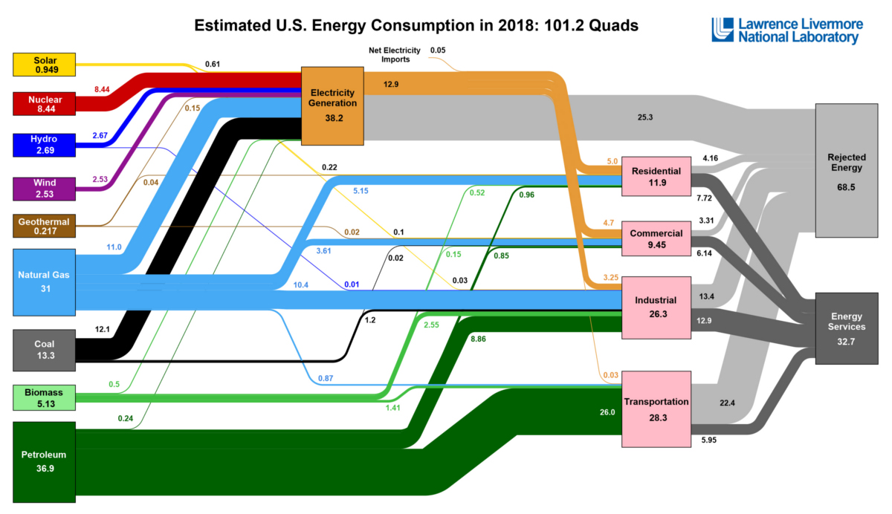

Visualizations, Infographics, Interactives
Tufte Data to Ink Ratio

Slide 13
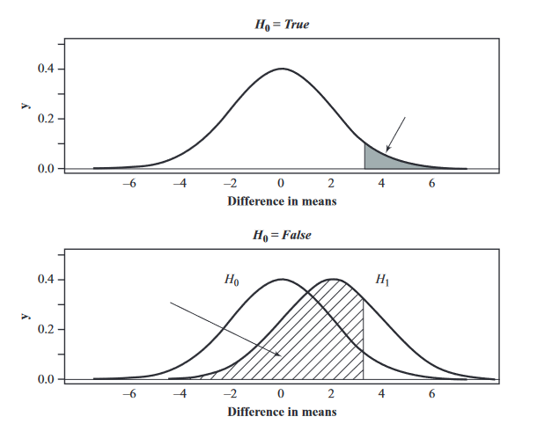
Inferential Statistics
Deductive vs. Inductive Reasoning
Inductive reasoning is a type of reasoning where you make conclusions based on observations or evidence
Deductive reasoning is a type of reasoning where you make conclusions based on a set of premises or assumptions that are assumed to be true
Null Hypothesis Testing
What is it?
Is it inductive or deductive?

Slide 14

Advantages of Null Hypothesis Testing
Null hypothesis testing provides a framework for rigorous and objective testing of research findings.
It controls for Type I and Type II errors, minimizing the risk of incorrect conclusions.
Notes:
Rigor and objectivity: Null hypothesis testing provides a framework for researchers to test the significance of their findings in a rigorous and objective manner. By defining a null hypothesis (H0) and an alternative hypothesis (H1), researchers can use statistical tests to determine whether there is sufficient evidence to reject the null hypothesis in favor of the alternative. Controlling for Type I and Type II errors: Null hypothesis testing is designed to minimize the risk of making incorrect conclusions. By setting a significance level (α), researchers can control the probability of committing a Type I error (false positive) and, with power analysis, they can also control the risk of Type II error (false negative). This helps to increase the reliability of the research findings. Reproducibility and comparability: The use of null hypothesis testing allows for better reproducibility and comparability across studies. By adhering to a standardized methodology, researchers can more easily replicate studies and compare their results, thus contributing to the accumulation of knowledge in experimental psychology. Establishing cause-effect relationships: Null hypothesis testing can help establish causal relationships between variables. By controlling for potential confounding variables and random error, researchers can determine whether their experimental manipulation caused the observed effect on the dependent variable. Incentive for well-designed experiments: The requirement for a significant result to reject the null hypothesis incentivizes researchers to design experiments with adequate statistical power, ensuring that their findings are robust and meaningful. Facilitates meta-analysis: Null hypothesis testing provides a common framework for aggregating results from multiple studies, which can be useful in meta-analyses. By synthesizing findings across studies, researchers can draw more accurate and generalizable conclusions about a given phenomenon in experimental psychology. Education and communication: Null hypothesis testing is a widely taught method in psychology, making it easy for researchers to understand and communicate their findings to others. By using a shared language, researchers can more effectively collaborate and build on each other's work.

Slide 15
Statistical Significance
Probability the observed data is due to chance alone
Indicates the reliability of finding the effect
Has no relation to the Practical Significance or Meaningfulness of the result

Slide 16
Advantages of Null Hypothesis Testing
The standardized methodology allows for reproducibility and comparability across studies.
It helps establish causal relationships between variables by controlling for potential confounding variables and random error.
The requirement for a significant result incentivizes well-designed experiments with adequate statistical power.
Null hypothesis testing facilitates meta-analysis, allowing for more accurate and generalizable conclusions.
It is a widely taught method in psychology, allowing for effective communication and collaboration among researchers.
Notes:
Rigor and objectivity: Null hypothesis testing provides a framework for researchers to test the significance of their findings in a rigorous and objective manner. By defining a null hypothesis (H0) and an alternative hypothesis (H1), researchers can use statistical tests to determine whether there is sufficient evidence to reject the null hypothesis in favor of the alternative. Controlling for Type I and Type II errors: Null hypothesis testing is designed to minimize the risk of making incorrect conclusions. By setting a significance level (α), researchers can control the probability of committing a Type I error (false positive) and, with power analysis, they can also control the risk of Type II error (false negative). This helps to increase the reliability of the research findings. Reproducibility and comparability: The use of null hypothesis testing allows for better reproducibility and comparability across studies. By adhering to a standardized methodology, researchers can more easily replicate studies and compare their results, thus contributing to the accumulation of knowledge in experimental psychology. Establishing cause-effect relationships: Null hypothesis testing can help establish causal relationships between variables. By controlling for potential confounding variables and random error, researchers can determine whether their experimental manipulation caused the observed effect on the dependent variable. Incentive for well-designed experiments: The requirement for a significant result to reject the null hypothesis incentivizes researchers to design experiments with adequate statistical power, ensuring that their findings are robust and meaningful. Facilitates meta-analysis: Null hypothesis testing provides a common framework for aggregating results from multiple studies, which can be useful in meta-analyses. By synthesizing findings across studies, researchers can draw more accurate and generalizable conclusions about a given phenomenon in experimental psychology. Education and communication: Null hypothesis testing is a widely taught method in psychology, making it easy for researchers to understand and communicate their findings to others. By using a shared language, researchers can more effectively collaborate and build on each other's work.

Slide 17
Criticisms of Null Hypothesis Testing
Overemphasis on p-values can lead to overlooking practical importance of effect sizes and other meaningful measures.
The significance level of 0.05 is an arbitrary threshold and relying on it can lead to incorrect conclusions.
Null hypothesis testing only allows for rejecting or failing to reject the null hypothesis, making it difficult to interpret non-significant results.
Multiple comparisons problem can increase the likelihood of Type I errors when conducting multiple hypothesis tests in a single study.
Emphasis on statistically significant results in null hypothesis testing may contribute to publication bias, distorting our understanding of true effect sizes.

Slide 18
Alternatives to Null Hypothesis Testing
Exploratory data analysis (EDA): EDA emphasizes visualizing and summarizing data to identify patterns, trends, and relationships
Model comparison and selection: Instead of focusing on null hypothesis testing, researchers can use model comparison (AIC, BIC). These methods help compare the goodness of fit and complexity of competing models while accounting for additional parameters
Measure populations instead of sampling
Inductive reasoning based on empirical data: This approach involves forming generalizations and theories based on observed patterns in data
Focus on practical significance of findings (inductive)
Bayesian (deductive)
Confidence Intervals (deductive, also fairly intuitive and graphical, Loftus and Masson 1994)

Slide 19
Establishing Causality without Null Hypothesis Testing
Alternative approaches focus on principles of causality: manipulation, control, and temporal precedence
Methods to demonstrate causality without null hypothesis testing:
Randomized controlled trials (RCTs)
Natural experiments
Longitudinal studies
Instrumental variable (IV) analysis
Granger causality
Propensity score matching
Causal diagrams and directed acyclic graphs (DAGs)
These methods can establish causality without relying on null hypothesis testing
They provide more nuanced and informative insights into causal relationships and help avoid limitations associated with null hypothesis testing.

Slide 20
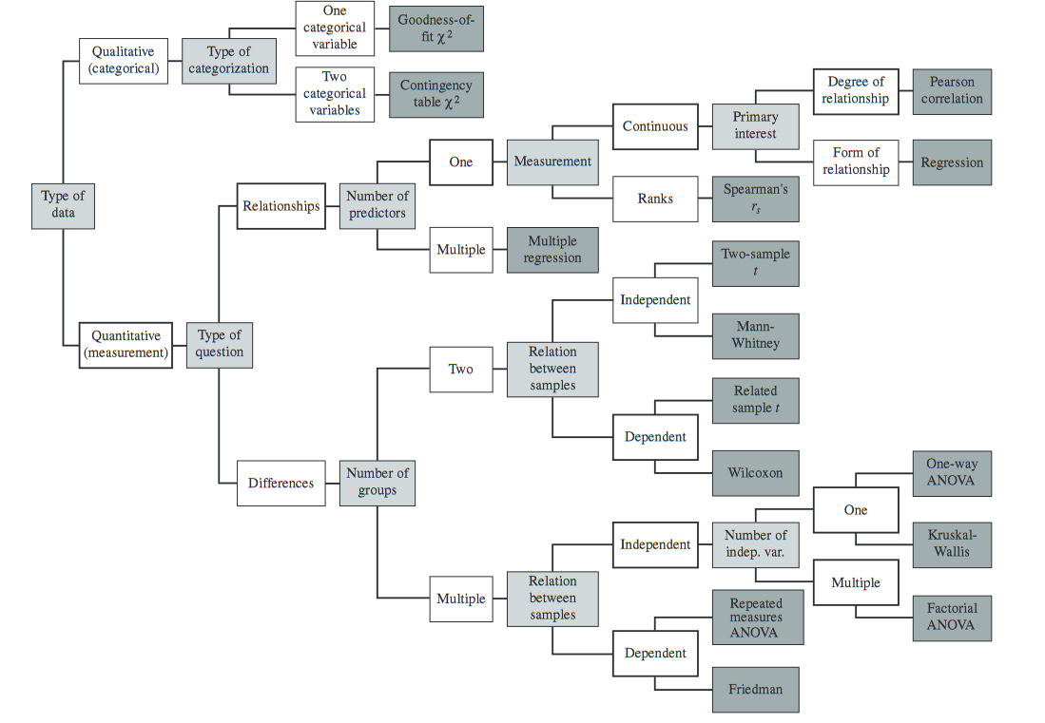
Howell Statistical Methods for Psychology
https://labs.la.utexas.edu/gilden/files/2016/05/Statistics-Text.pdf

Slide 21
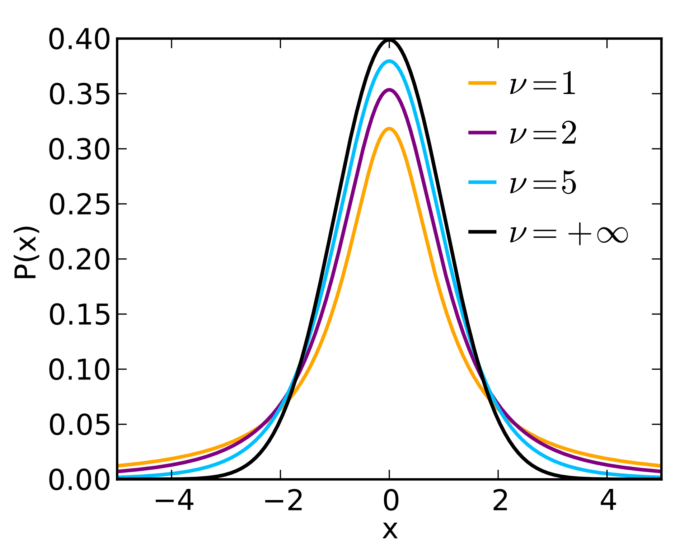
Inferential Statistics
T distribution
Premise
What is a test-statistic T, F, chi-square?
What is a p-value?
What is Type I vs. Type II error
power
Continuous, Categorical, Ordinal
Parametric vs. Non-Parametric
Homogeneity of variance
Other assumptions

Slide 22
Transformations for correcting heterogeneity
Log
Good for long tails
Inverse (1/x)
Good for increasing variability at tails
Windsor Trim (1, 5, 10%)
Outliers
Caveats
Should plot and interpret the transformed data
Trimming removes degrees of freedom (decreases power)

Slide 23
T-Tests
1 sample
Comparison to a known population mean
2 sample
Paired
Equal variance
Unequal variance
1-tail vs. 2-tail

Slide 24
1 way ANOVA
When to use?
Test for homogeneity of variance
Marginal statistics (descriptives by group)
Post-hoc
Tukey
Newman-Keuls
Main Effects
https://rogerlew.github.io/pyvttbl_doc/Anova1way.html

Slide 25
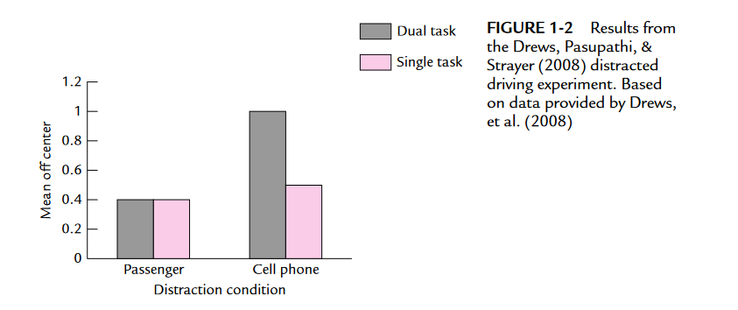

Slide 26
Factorial ANOVA
Factorial ANOVA is needed when you want to investigate the effects of two or more independent variables on a dependent variable.
It is also needed when you want to determine whether there is an interaction effect between the independent variables, and to test the main effects of each independent variable.
Factorial ANOVA is particularly useful when the goal is to identify the specific effects of each independent variable and their interactions, rather than just looking at the effect of one variable while holding others constant.

